Slide 1
Clementine Productions~
CorkBoard Course Planner
Chase Maivald
Paige Hartley
Ranaq Zamal
Nafis Abeer

Slide 2
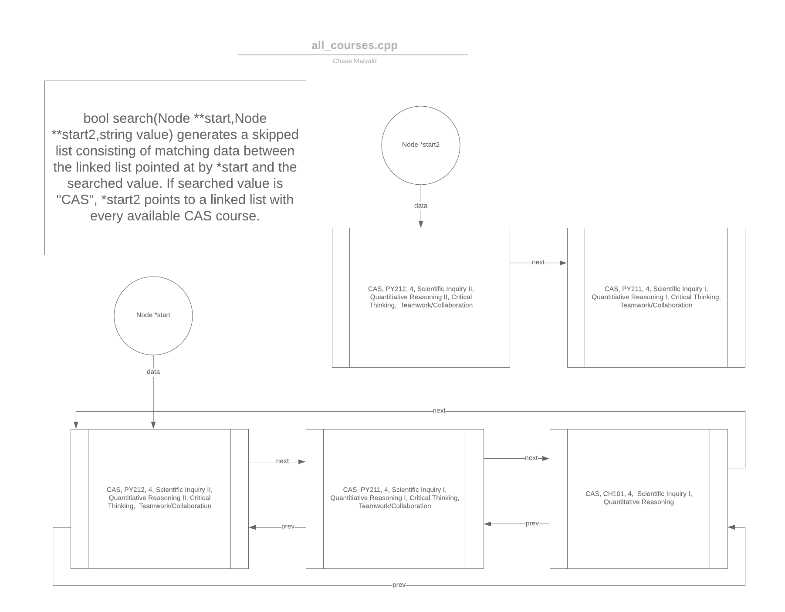
Dataset 1

Slide 3
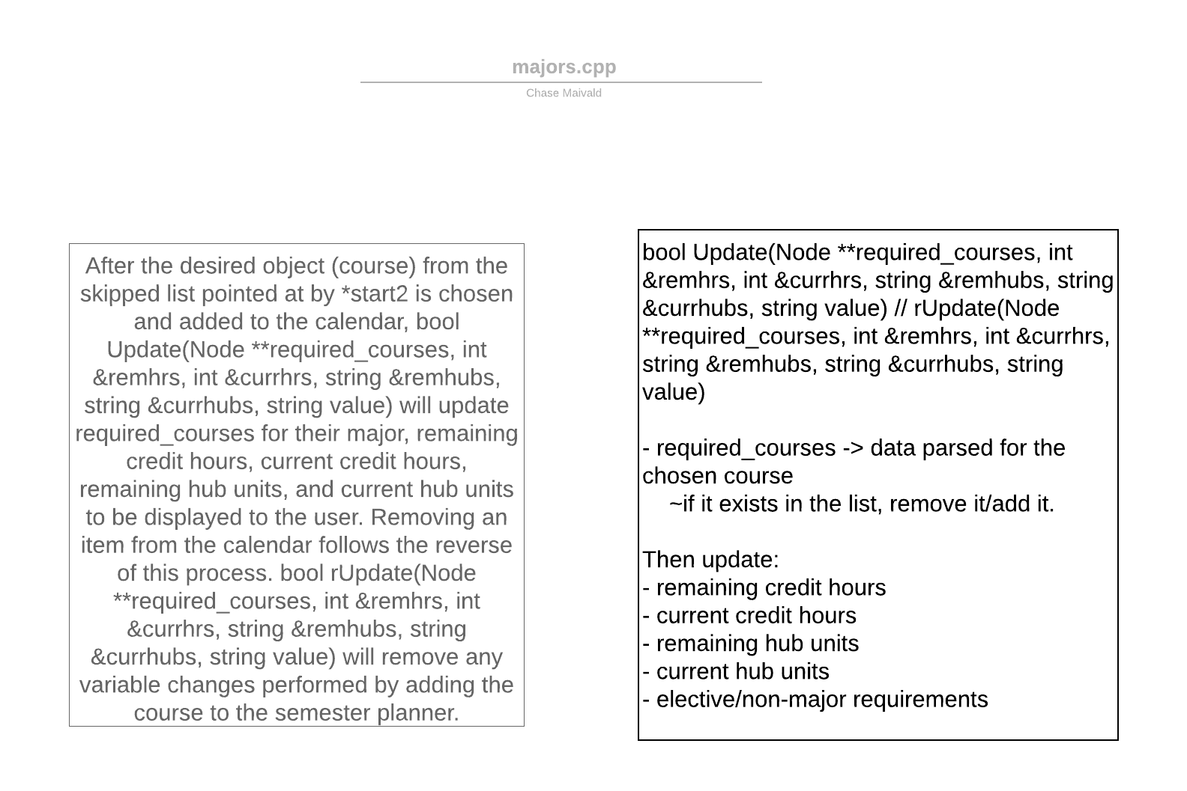
Database 2

Slide 4
Pulling from Database
The datasets are written in C++ and managed in C#
The C++ data is imported in the .NET core structure by creating an unmanaged DLL from it
Dllimport & dllexport create alias wrapper functions, which are able to be called indirectly in the C# program

Slide 5
GPA calculator
C# function implementation that can calculate a user’s cumulative GPA based on courses in which they received a course grade
If a goal GPA is specified, this function will calculate the average GPA/ungraded course grades required to graduate with that GPA

Slide 6
Class DBsession
Class structure that creates a user ID, so user entered data may be stored in their current session
This allows for the potential implementation of user login, so closing the application does not delete a past session
Member functions can access datasets all_courses.cpp and majors.cpp

Slide 7
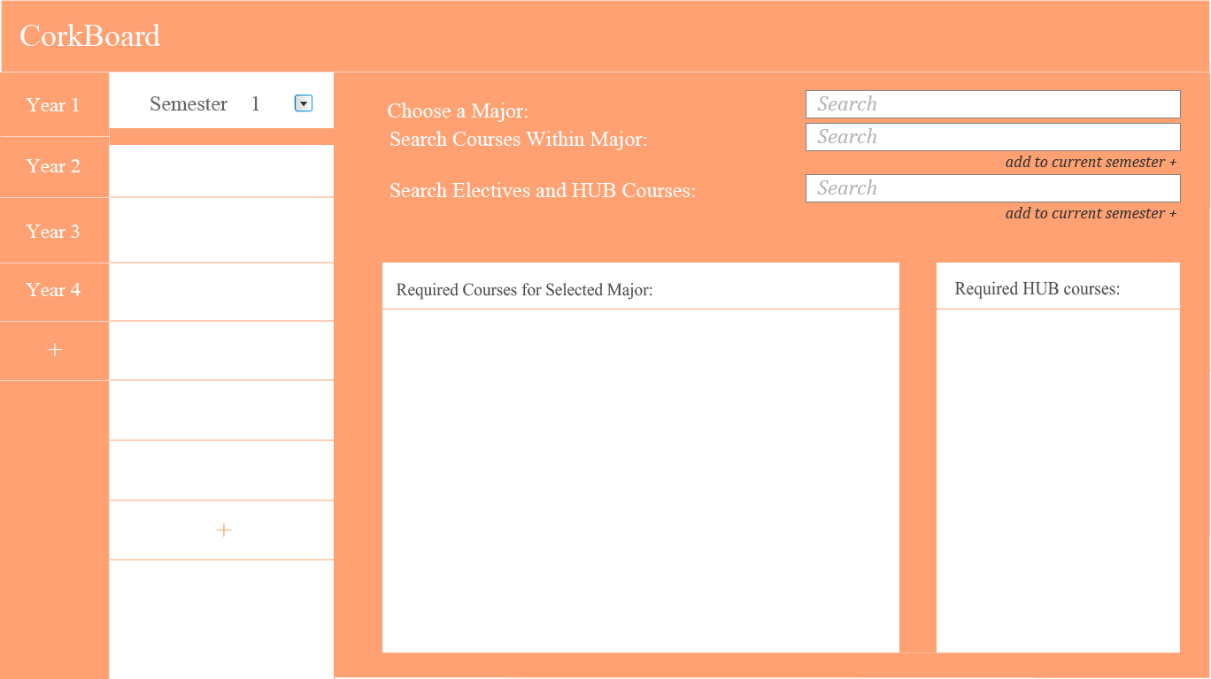
WPF Application

Slide 8
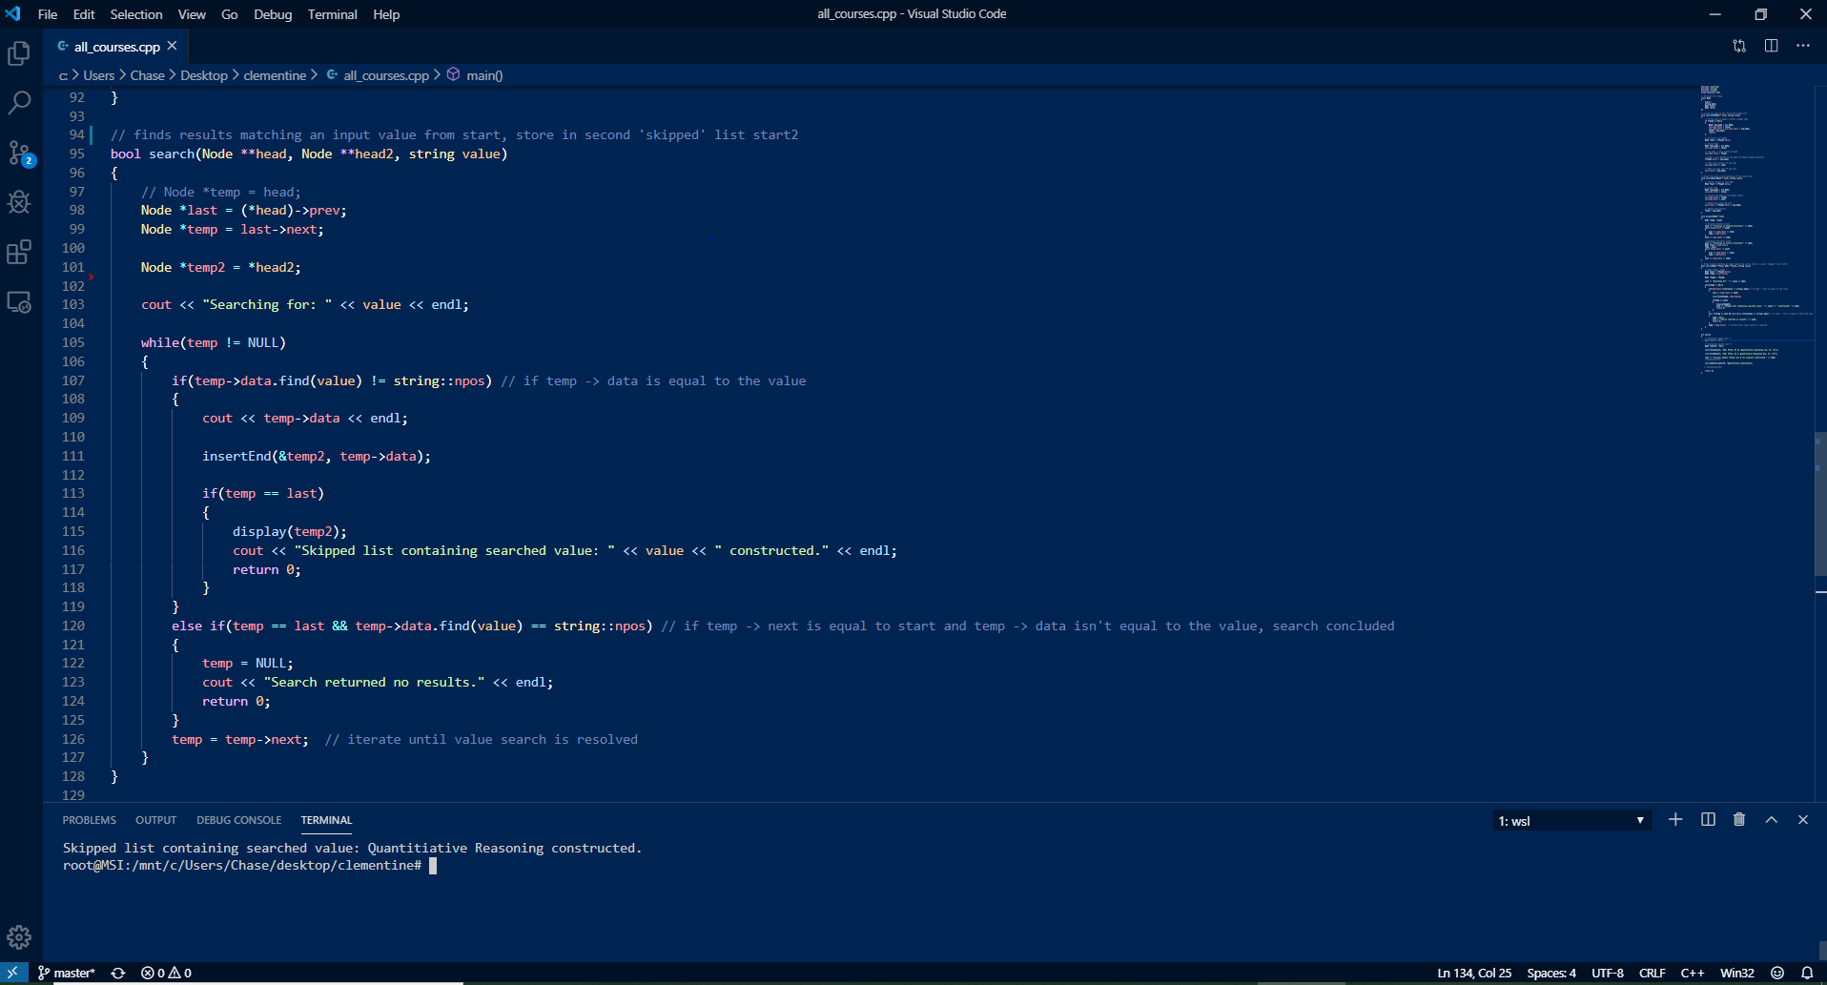
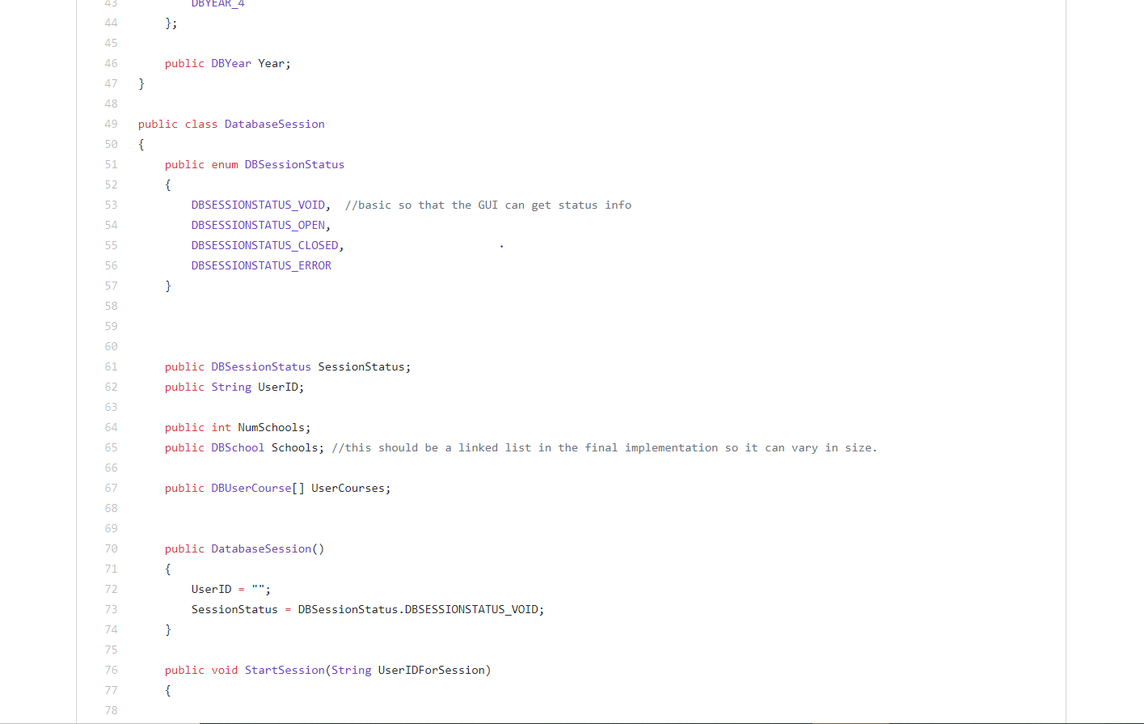
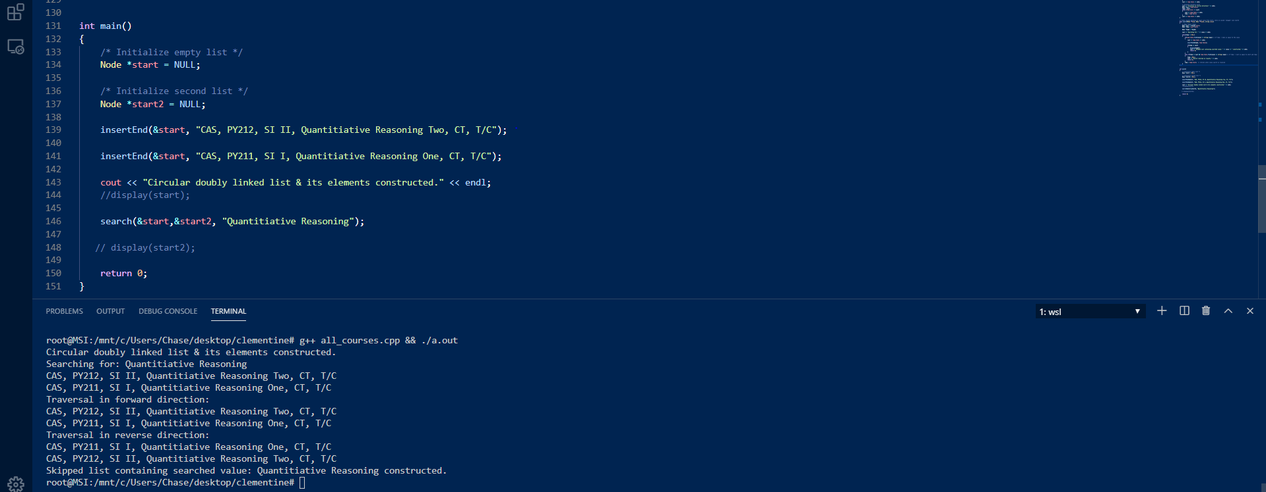
Code Snippets
DBsession.cs
all_courses.cpp

Slide 9
Difficulties
Potential database architecture of a hash table + hash function for efficient memory access
Attempting to web-scrape all courses from BU in Python using the Beautiful Soup library
Coalescing data architecture to the .NET shell

